Slide 1


JAVA INTERVIEW BOOTCAMP
Lecture 12

Slide 2

Today’s Agenda
Introduction To Array
Syntax Of Array Declaration
MultiDimensional Arrays
Popular Interview Questions

Slide 3
What Is an Array ?
Arrays are indexed based collection of homogeneous data.
In other words , we can say they are a set of data elements of the same type and are always accessed using their index nos.

Slide 4
What Are Arrays In Java ?
Arrays are objects in Java that store homogeneous data.
They hold either primitives or object references, but the array itself will always be an object
They are always created dynamically
They live in memory area called heap

Slide 5
When We Should Use Arrays ?
Arrays should only be used in 2 cases:
When we already know the number of elements to be stored, for example , weekdays in a week
At run time , we don’t want to increase or decrease array size.
If any of the above criteria does not hold , then we must consider using COLLECTIONS

Slide 6
Declaring Array
Arrays are declared by stating the type of element the array will hold, which can be an object or a primitive, followed by square brackets to the left or right of the identifier.

Slide 7

Declaring Array
Declaring an array of primitives.
What will you call the identifier key in the above declaration ?
It is a reference to an array object containing array of integers.

Slide 8

Declaring Array
Declaring an array of non-primitives.
What will you call the identifier threads in the above declaration ?
It is a reference to an array object containing references to Thread object

Slide 9
Declaring Array
The first example is a three-dimensional array (an array of
arrays of arrays) and the second is a two-dimensional array.
In the second example we have one square bracket before the variable name and one after.
This is perfectly legal to the compiler but not recommended

Slide 10
Popular Interview Question
How are the following two declarations different ?
int [ ] arr,brr;
AND
int arr[ ],brr;
In the first declaration both arr and brr are array references while in the second declaration only arr is an array reference while brr is an integer variable.

Slide 11
Popular Interview Question
How are the following two declarations different ?
int [ ] arr,[] brr;
AND
int arr[ ],brr[ ];
In the first declaration the compiler will give syntax error while in the second declaration both arr and brr are array references.

Slide 12
Popular Interview Question
Explain the following declaration ?
int [ ] arr, brr[ ];
The declaration is perfectly valid and arr will be a 1 D array reference while brr will be a 2D array reference

Slide 13
Constructing an Array
Constructing an array means creating the array object on the heap (where all objects live)—that is, doing a new on the array type

Slide 14

Constructing A 1 D Array
The easiest way to construct an array is to use the keyword new followed by the array type, with a bracket specifying how many elements of that type the array will hold.
The following is an example of constructing an array of type int:

Slide 15
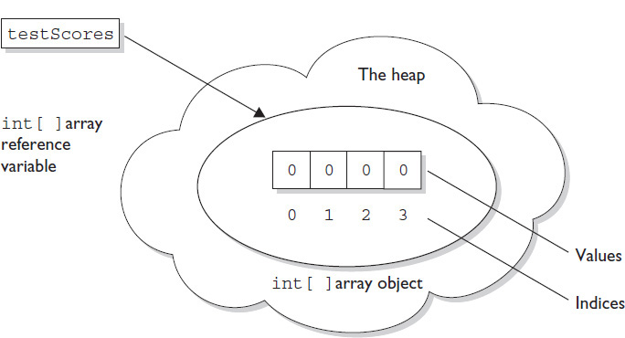
Constructing A 1 D Array
The code puts one new object on the heap—an array object holding four elements—with each element containing an int with a default value of 0.

Slide 16
Constructing A 1 D Array
Arrays of object references can be constructed in the same way:

Slide 17
Very Important For Interview
Think carefully about how many objects are on the heap after a code statement or block executes.
The interviewer will expect you to know this!

Slide 18

Very Important For Interview
Can you tell in how many objects the preceding code creates ?
The preceding code produces just one object (the array assigned to the reference variable named threads).
The single object referenced by threads holds five Thread reference variables, but no Thread objects have been created or assigned to those references.

Slide 19
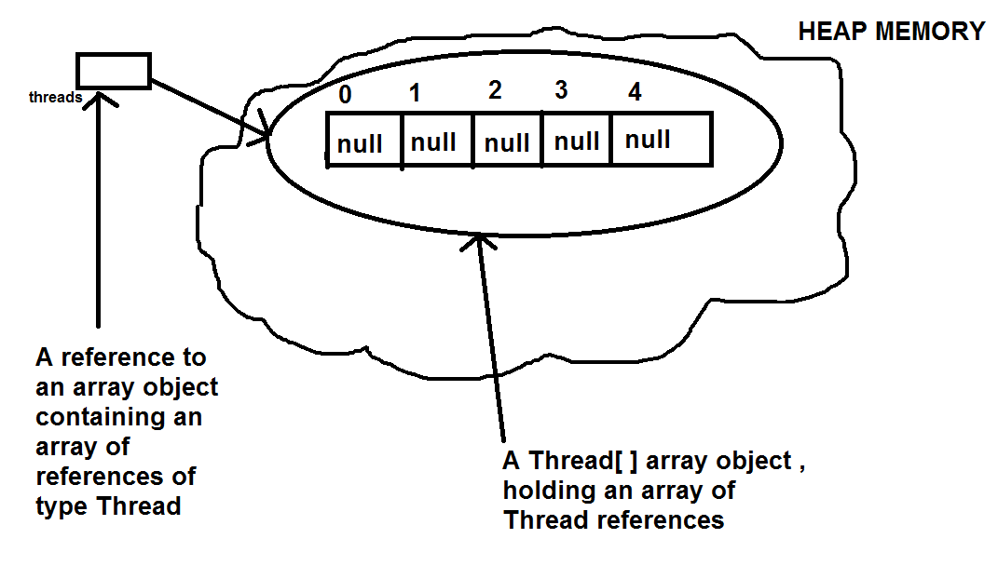
Very Important For Interview

Slide 20
MultiDimensional Array
It is sometimes useful to have an array with more than one index
Multidimensional arrays are declared and created in basically the same way as one-dimensional arrays
We simply use as many square brackets as there are indices
Each index must be enclosed in its own brackets
double[ ][ ]table = new double[100][10];
int[ ][ ][ ] figure = new int[10][20][30];
Person[ ][ ] = new Person[10][100]

Slide 21
Types Of MultiDimensional Array
Java allows us to declare MultiDimensional arrays of 2 types:
Rectangular Arrays
Where each row is of same length ,i.e. number of columns in each row is same.
Jagged Arrays
Where each row can have different length

Slide 22
Rectangular Array
int [ ][ ] A;
A = new int[ ][ ] { { 1, 0, 12, -1 }, { 7, -3, 2, 5 }, { -5, -2, 2, -9 } };
This is LOGICAL VIEW of an array , not its actual diagram

Slide 23
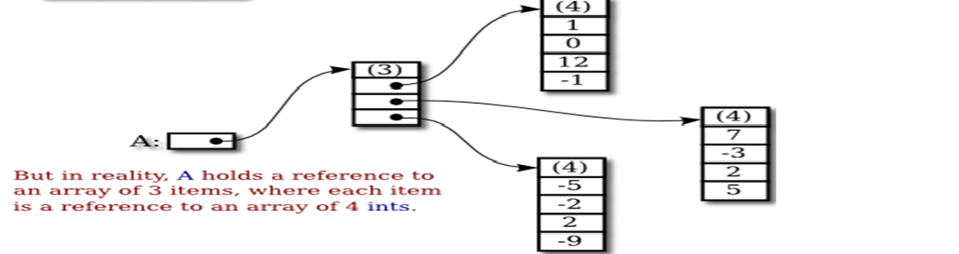
Actual Memory Diagram
int [ ][ ] A;
A = new int[ ][ ] { { 1, 0, 12, -1 }, { 7, -3, 2, 5 }, { -5, -2, 2, -9 } };

Slide 24
Jagged Array
Each row in a two-dimensional array need not have the same number of elements
Different rows can have different numbers of columns
An array that has a different number of elements per row it is called a jagged array

Slide 25
Jagged Array
double [ ][ ] a;
a = new double[3][ ];
a[0] = new double[5];
a[1] = new double[10];
a[2] = new double[4];

Slide 26
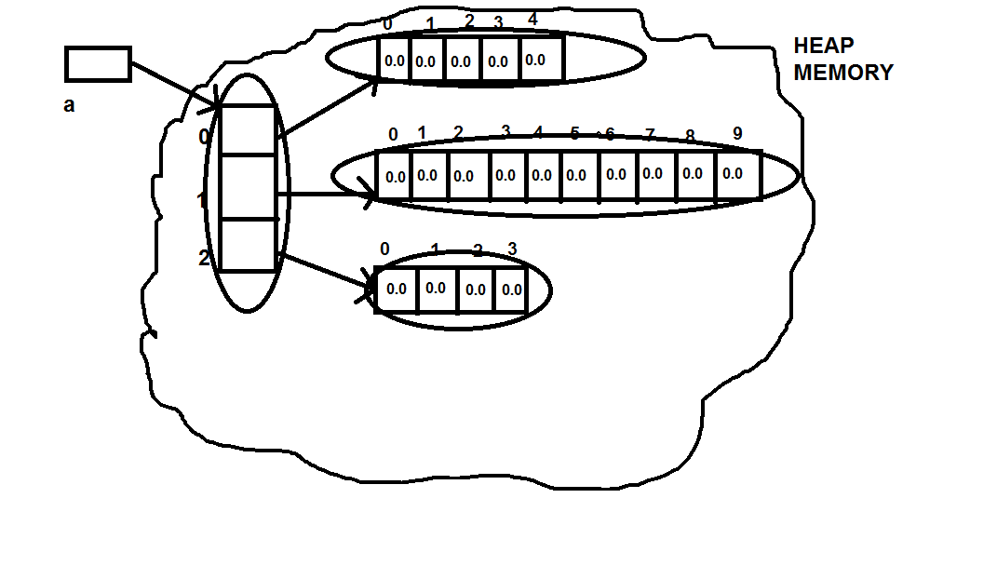
Jagged Array
How many objects are created ?
4 Objects

Slide 27
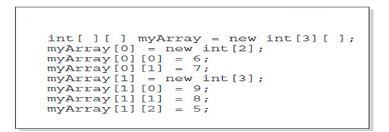
Popular Interview Question
Explain the following code:

Slide 28
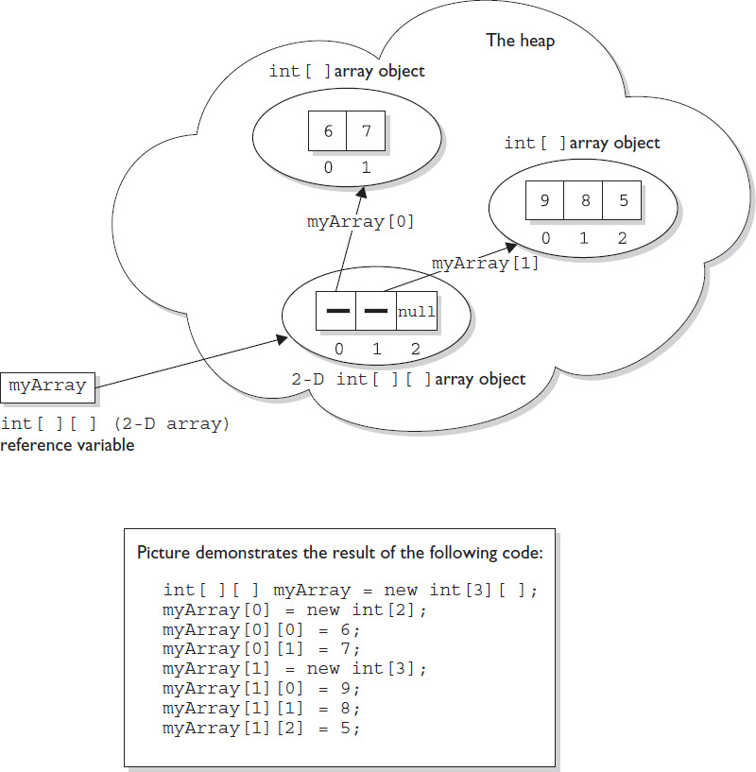
Popular Interview Question
Memory diagram of the previous code:

Slide 29
Popular Interview Question
How many object are created in the following ode:
Three objects will be created

Slide 30
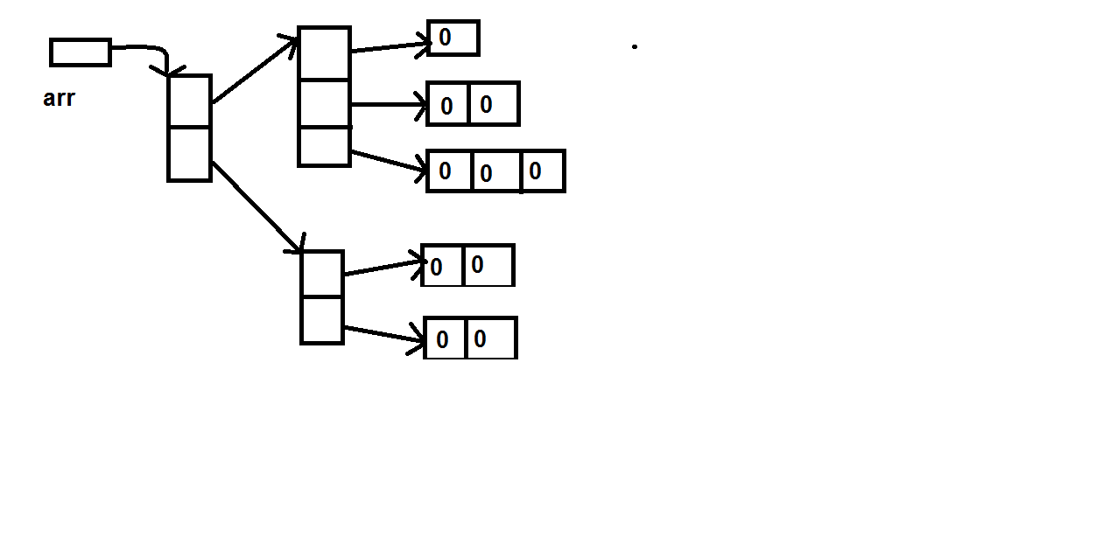
Popular Interview Question
Write the array declaration for the following diagram ?
int [][][]arr=new int[2][][];
arr[0]=new int[3][ ];
arr[1]=new int[2][ ];
arr[0][0]=new int[1];
arr[0][1]=new int[2];
arr[0][2]=new int [3];
arr[1][0]=new int [2];
arr[1][1]=new int [2]
How many objects are created ?
8 Objects

Slide 31
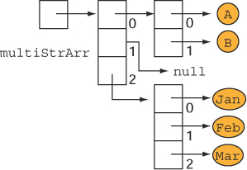
Popular Interview Question
Draw the memory diagram for the following code ?
Code:
String multiStrArr[][] = new String[][]{ {"A", "B"}, null, {"Jan", "Feb", "Mar“}};

Slide 32
Popular Interview Questions
Explain the following declarations:
int[ ] arr,brr;
// arr is 1D array , brr is a 1D array
int [ ] arr[ ],brr;
//arr is a 2D array, brr is a 1D array
int [ ] arr[ ] ,brr[ ];
// arr and brr , both are 2D array
int [ ][ ] arr,brr;
// arr and brr , both are 2D array

Slide 33
Popular Interview Questions
Explain the following declarations:
int[ ] [ ]arr,brr[ ];
// arr is 2D array , brr is a 3D array
int [ ] [ ]arr,[ ]brr;
//Syntax Error. Dimension before brr is not allowed

Slide 34
Popular Interview Questions
If arrays are objects , what is the name of their class ?
The class for any kind of array is internally created by java language and not available to the programmer directly.

Slide 35
Popular Interview Questions
What are the names of these classes ?
The names are as follows:
int I
short S
byte B
long L
float F
double D
char C
boolean Z
These class names will be prefixed with number of [ indicating the dimensions of the array

Slide 36
Popular Interview Questions
Can we print these class names?
Yes , by calling the getClass () method followed by getName() method.

Slide 37
Popular Interview Questions
int []arr,brr[];
brr=new int[2][3];
arr=new int[4];
System.out.println(arr.getClass().getName());
System.out.println(brr.getClass().getName());
Output:
[I
[[I

Slide 38
Popular Interview Questions
What is the output of the following code? (Suppose Student is a class)
Student [ ] s=new Student[5];
System.out.println(s.getClass().getName());
Output:
[LStudent;
Note this ; , even it is the part of internal class name for the array reference object

Slide 39
Popular Interview Questions
What is the output of the following code?
String [ ][ ]s=new String[5][10];
System.out.println(s.getClass().getName());
Output:
[[Ljava.lang.String;

Slide 40
Popular Interview Questions
What is the output of the following code?
int[ ] arr=new int[ ];
System.out.println(arr.getClass().getName());
Output:
Syntax Error: array dimension missing
Conclusion:
It is compulsory to provide array size while creating the array

Slide 41
Popular Interview Questions
What is the output of the following code?
int[ ] arr=new int[0];
System.out.println(arr.length);
Output:
0
Conclusion:
It is perfectly valid to have an array of size 0

Slide 42
Popular Interview Questions
What is the output of the following code?
int[ ] arr=new int[-5];
System.out.println(arr.length);
Output:
Exception: NegativeArraySizeException
Conclusion:
It is syntactly valid to have an array of negative size but at run
time the JVM will raise the Exception

Slide 43
Popular Interview Questions
What is the output of the following code?
int[ ] arr=new int[‘Z’];
System.out.println(arr.length);
Output:
90
Conclusion:
No other constant except byte , short , char and int is allowed
to be used as array size

Slide 44
Popular Interview Questions
What is the output of the following code?
int[ ] arr=new int[25L];
System.out.println(arr.length);
Output:
Syntax Error: incompatible types: possible lossy
conversion from long to int
Conclusion:
Any constant of type other than byte , short , char and
int is strictly not allowed to be used as array size

Slide 45
Popular Interview Questions
What is the output of the following code?
int[ ] arr=new int[2147483648];
System.out.println(arr.length);
Output:
Syntax Error: error: integer number too large:
2147483648
Conclusion:
Array size can never exceed 2147483647

Slide 46
Popular Interview Questions
What is the output of the following code?
int[ ] arr=new int[2147483648L];
System.out.println(arr.length);
Output:
Syntax Error: error: possible lossy conversion from long to int
Conclusion:
Array size can never exceed 2147483647

Slide 47
Popular Interview Questions
What is the output of the following code?
int[ ] arr=new int[(int)2147483648L];
System.out.println(arr.length);
Output:
NegativeArraySizeException
Conclusion:
Array size can never exceed 2147483647

Slide 48
Popular Interview Questions
What is the output of the following code?
int[ ] arr=new int[2147483647];
System.out.println(arr.length);
Output:
Exception:java.lang.OutOfMemoryError: Requested array size
exceeds VM limit
Conclusion:
Syntactically array size can be up to 2147483647 but at runtime
exception can arise if in heap the requested space is not available

Slide 49
Popular Interview Questions
Which declarations are correct ?
int[ ] arr=new int[ ];
// wrong , size is compulsory
int [ ] arr=new int [5];
// correct , size mentioned
int [ ][ ]arr=new int[ ][ ];
// wrong , atleast base size is needed
int [ ][ ] arr=new int [5][ ];
// correct , base size mentioned

Slide 50
Popular Interview Questions
Which declarations are correct ?
int[ ][ ] arr=new int[ ][5];
// wrong , base size is compulsory
int [ ][ ] arr=new int [5][4];
// correct , size mentioned
int [ ][ ][ ]arr=new int[3][4][6];
// correct , size mentioned
int [ ][ ][ ] arr=new int [5][4][ ];
// correct , base size mentioned

Slide 51
Popular Interview Questions
Which declarations are correct ?
int[ ][ ][ ] arr=new int[4 ][ ][6];
// wrong , without second dimension third
//dimension cannot be specified
int [ ][ ][ ] arr=new int [ ][5][4];
// wrong , without first dimension second
//dimension cannot be specified

Slide 52
Popular Interview Questions
What is the output of the following code?
int[ ] arr=new int[3];
System.out.println(arr);
System.out.println(arr[0]);
Output:
[I@6A4F321
0
Conclusion:
Whenever we print any reference variable , internally
toString( ) method gets called , which by default returns a
String as <classname>@<hashcode>

Slide 53
Popular Interview Questions
What is the output of the following code?
int[ ][ ] arr=new int[3][3];
System.out.println(arr);
System.out.println(arr[0]);
System.out.println(arr[0][0]);
Output:
[[I@6A4F321
[I@4BE62A1
0
Conclusion:
Since arr is a reference to 2D array so we got [ [ I. . . .
arr[0] is a reference to a 1D array so we got [I. . .

Slide 54
Popular Interview Questions
What is the output of the following code?
int[ ] [ ]arr=new int[3][];
System.out.println(arr);
System.out.println(arr[0]);
System.out.println(arr[0][0]);
Output:
[[I@6A4F321
null
NullPointerException
Conclusion:
Since arr is a reference to 2D array so we got [ [ I. . . .
arr[0] is pointing nowhere and is by default set to null.
But if we try to access null’s value then java will throw a
NullPointerException

Slide 55
Popular Interview Questions
What is the output of the following code?
int[ ] arr=new int[3];
System.out.println(arr[0]);
System.out.println(arr[3]);
Output:
0
ArrayIndexOutOfBoundsException
Conclusion:
Default value for all array elements is 0 . So arr[0] is 0
But accessing an array beyond it’s upper or lower bound is an exception,
so the code arr[3] will throw ArrayIndexOutOfBoundsException

Slide 56
Popular Interview Questions
What is the output of the following code?
int[ ] arr=new int[3];
System.out.println(arr[0]);
System.out.println(arr[-3]);
Output:
0
ArrayIndexOutOfBoundsException
Conclusion:
Default value for all array elements is 0 . So arr[0] is 0
But accessing an array beyond it’s upper or lower bound is an exception,
so the code arr[-3] will throw ArrayIndexOutOfBoundsException

Slide 57
Popular Interview Questions
What is the output of the following code?
int[ ] arr=new int[3];
System.out.println(arr[0.5]);
System.out.println(arr[-3]);
Output:
Syntax Error: incompatible types: possible lossy
conversion from double to int
Conclusion:
Any constant/value of type other than byte , short , char and
int is strictly not allowed to be used as array index

